Slide 1
A Fresh Look at HR Basics
Bringing the “Human” back to Human Resources

Slide 2
Objectives
Explore the changing scope of Human Resources
Strategies and Action Plans for starting a new role
Communication techniques for success
Pitfalls to avoid
Onboarding and Offboarding- some best practices
Remembering the human factor in Human Resources

Slide 3
So…..What Does a Human Resources Professional do, anyway?

Slide 4
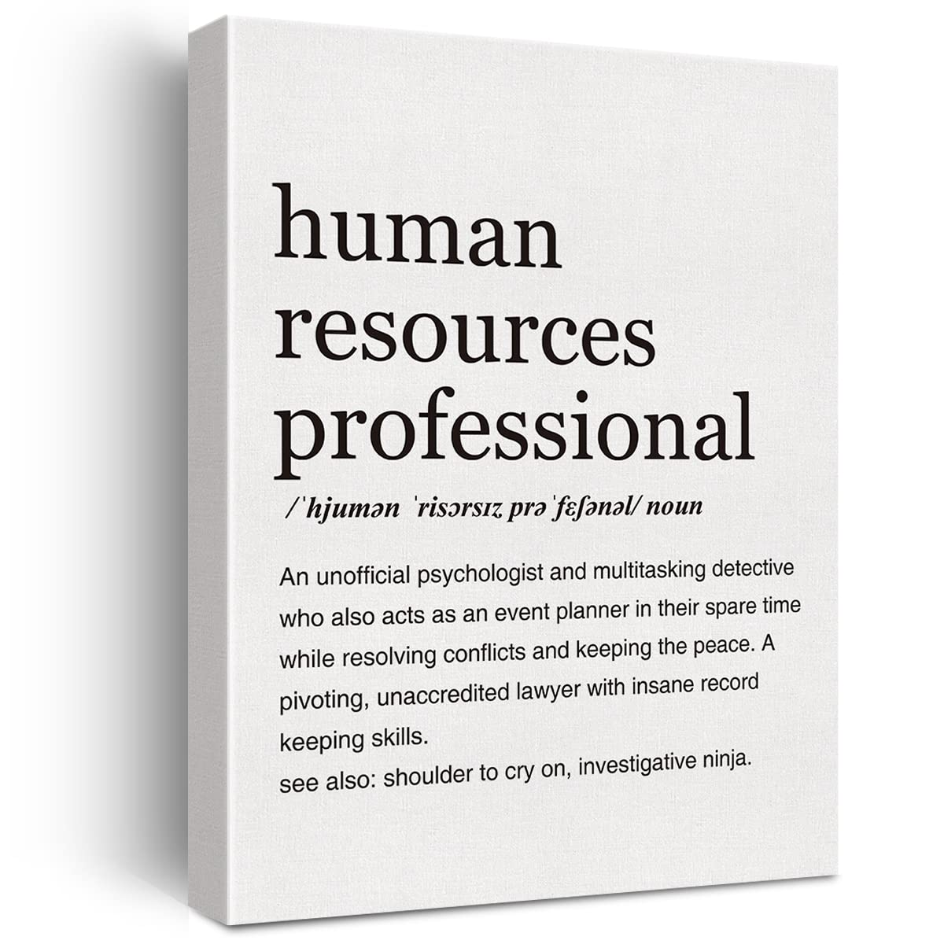

Slide 6
By Any Other Name…the Changing Role of HR
Personnel Human Resources
Human Resources HR Business Partner
Learning and Development Employee Journey Guide
Chief People Officer People and Culture
Employee Benefits Employee Wellness
Employee Relations Chief Heart Officer

Slide 7
Poll
How many have experienced increased responsibilities or have taken on a new role or job since the advent of the pandemic?
How many of you in this room have experienced burnout in one time or another in your career?
Since the pandemic?

Slide 8
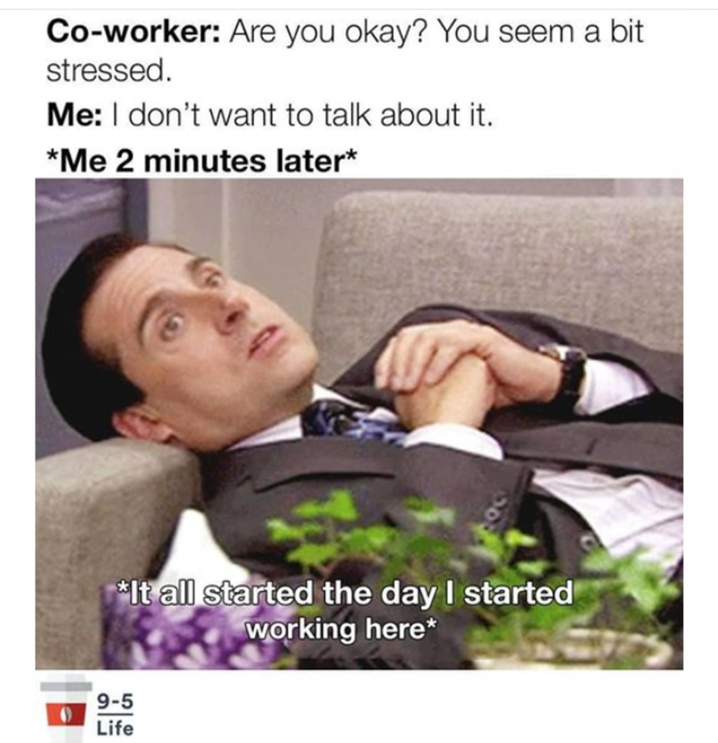
HR statistics on Burnout
Forbes: 98% of HR Professionals are experiencing burnout
HR Executive: 53% said they were experiencing burnout
48% looking for a new role; of those 78% sited burnout in their current role as a factor.

Slide 9
10 Jobs workers are most likely to quit in 2023
JOBS | MEDIAN SALARY | RATE AT WHICH WORKERS ARE LOOKING FOR NEW JOBS
Senior Customer Service Representative | $44K | 65%
Human Resources Specialist | $54K | 62%
Customer Success Manager | $81K | 61%
Public Relations Specialist | $57K | 59%
Creative Director | $97K | 57%
Controls Engineer | $85K | 56%
Human Resources Assistant | $41K | 55%
Medical Coding Specialist | $46K | 52%
Software Development Manager | $153K | 52%
Production Manager, Manufacturing | $77K | 48%
The table shows 10 jobs that workers are most likely to quit in 2023.
Source: CNBC; Payscale analysis of proprietary data from October 2021 and October 2022

Slide 10
Create a Plan
BENEFITS
“30-60-90”
Sets a tone with your team and internal customers
You can quantify your accomplishments more easily
Keeps you focused and prevents you from becoming overwhelmed
Maintains the “Human Factor” in the forefront of your plan

Slide 11
First 30 Days
PEOPLE FIRST! BUILD RELATIONSHIPS!
STUDY THE ORG CHART
What is the structure?
Functional areas?
How long have people been in their positions?
What seem to be the “crucial” positions?
Key Stakeholders? Some may not be on Org Chart (e.g., Union)

Slide 12
First 30 Days
MEET THE PLAYERS
Schedule one-on-one meetings with the key players
Introduce yourself! Have an elevator speech. Establish credentials - - but stay humble.
LISTEN AND LEARN about their roles and responsibilities - Don’t assume from job title!
Ask positive and open-ended questions - use principles of Appreciative Inquiry

Slide 13
“We need to discover the root causes of success rather than
the root causes of failure. We
live in the world our questions create.”
~ David Cooperfield

Slide 14
Assumptions of Appreciative Inquiry
In every society, organization or group, something works
What we focus on becomes our reality
Reality is created in the moment. There are multiple realities
The very act of asking questions influences the group

Slide 15
Assumptions of Appreciative Inquiry
People have more confidence to journey to the future when they can carry parts of the past
If we carry parts of the past forward, it should be best of the past
It’s important to value differences
The language we use creates our reality
“The thin book of appreciative inquiry” by sue annis Hammond august, 2013

Slide 16
Appreciative Inquiry
it’s about

Slide 17
Principles of Appreciative Inquiry
Problem solving (half-empty)
Appreciative inquiry (half-full)
Felt Need - Identification of Problem
Analysis of causes (Blame)
Analysis and possible solutions
Action Planning
Basic Assumption: An organization is a problem to be solved
Appreciating and valuing the best of what is
Envisioning what might be (Positive Result)
Dialoguing what should be
Co-Constructing the new
Basic Assumption: An organization is a mystery to be embraced
Source: Cooperrider and Srivastava “Appreciative Inquiry Into Organizational Life” in research and Organizational Change and Development” 1987

Slide 18
QUESTIONS
Tell me about yourself.
How long have you been with the company?
What are your primary responsibilities?
Why are you proud to work here?
What is something you or your team accomplished here that you are especially proud of?
What (or who) made that possible? What was your contribution?
What are the biggest challenges facing you in your role in the coming months, and what could HR do to make your job easier or be more effective in your role?
What are the 3 most important things that HR could do to make a positive impact in the company?
What will we need to do to make these things to happen?
Who else is it important that I talk to in order to gain a better understanding of the company?

Slide 19
First 30 Days
GET OUT OF YOUR CHAIR…
….. (AND INTO THE BUSINESS!)
Visit the work
Go to meetings
How does your business make money?
Who are your competitors? (Market, Employees)
Check out the systems
HRIS? Excel? Payroll? Accounting? Security?
Note redundancies and opportunities for improvement
Important company cycles and deadlines?
ASK QUESTIONS. DON’T JUDGE……… BE A SPONGE.

Slide 20
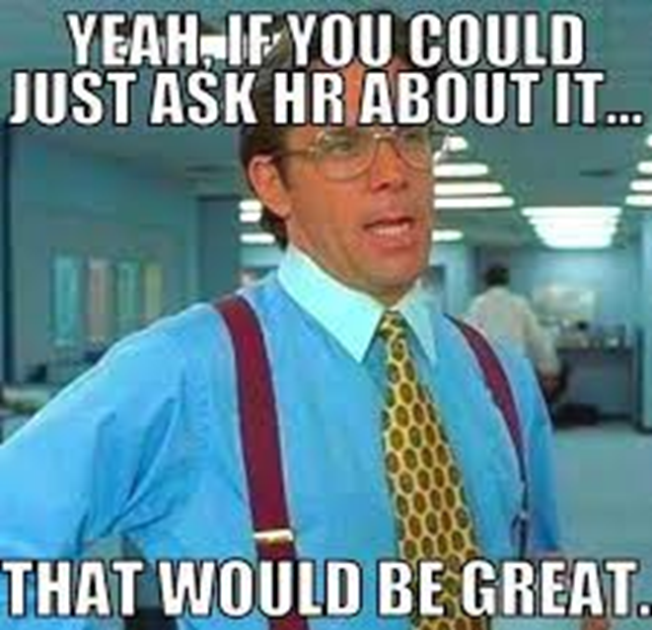
First 60 Days
EXPLORE THE CULTURE
What are the organizations values?
Is what is communicated what is practiced?
Do behaviors differ between teams, departments or functional units?
DON’T:
Tell them what needs to be fixed
Assign blame
“Well, this is how we did it at Know-It All Co”
Notes:
Lisa- Ask audience- why would we want to get to know the culture?
Why do you think it’s premature within the first 30 days to start telling them what needs to be fixed, assign blame or talk about your old company or agency?

Slide 21
First 60 days
CREATE A FEEDBACK SCHEDULE
Communication with your Manager is important
Create ongoing communication schedule with key players
START IDENTIFYING OPPORTUNITIES
Policies
Practices
Roles
Training
Systems

Slide 22
90 Days - REVIEW AND MAKE YOUR ACTION PLAN
PRIORITIZE ISSUES
Legal
Financial
Productivity based
IDENTIFY COLLABORATORS

Slide 23
90 Days - REVIEW AND MAKE YOUR ACTION PLAN
IDENTIFY DEPENDENCIES AND POTENTIAL ROADBLOCKS
Financial
Cross-Functional Workflows
Skill Based
Political
Emotional
Proximity

Slide 24
SARA - process CYCLE

Slide 25
WHERE TO START?
ONBOARDING AND ORIENTATION
HANDBOOK - POLICIES
FILE STRUCTURE, RETENTION, DESTRUCTION & SECURITY
I-9s
POSITIONS – JOBS, DESCRIPTIONS, EEO CLASSIFICATIONS (FLSA)
COMPENSATION – PAY SCALE AND RANGES

Slide 26
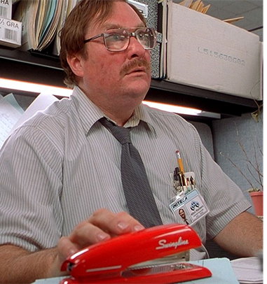
How would characterize your most recent onboarding experience?
Great! The team welcomed me with 15 pieces of flair
It was ok – I survived
Ignored - My red stapler and I were sent to the basement

Slide 27
ONBOARDING
Strong onboarding processes increase improve productivity by 50%.
88% of employees believe that their company doesn’t do onboarding well
58% of organizations onboarding programs primarily involve processes and paperwork.
Employees who attend a structured orientation program are 58% more likely to remain at the company for at least three years.

Slide 28
Remote Employee Considerations
#1: Have a dedicated (and active) coffee break chat to connect.
#2: Create opportunities to have fun together. ‍
#3: Set up regular check-ins. Regular and timely communication is important!
#4 Start silly traditions that add some fun to otherwise boring activities.
.
“In teamwork, silence isn't golden, it's deadly.”
~ Mark Sanborn

Slide 29
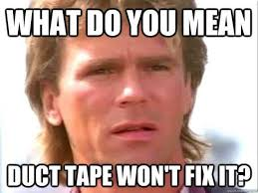
Be proactive, not reactive
Avoid the “One-size fits all” HR Department
Avoid having a know-it-all solution
Being too friendly/too unapproachable
Notes:
Teresa: Differences – fair and consistent

Slide 30
QUESTIONS?

